Slide 1
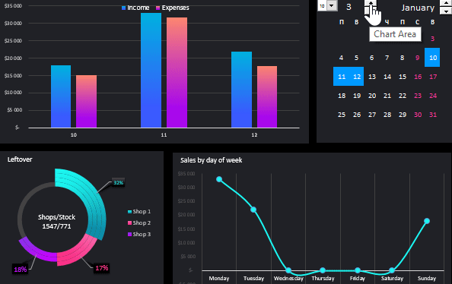
Snapchat Ads Dashboard Visualizations
Using IBM
Cognos Analytics
Team Members
T.Shailendra – 19R11A0539
T.Saketh sai – 19R11A0540
V.Jeeshitha – 19R11A0542
V.Pooja – 19R11A0543
V.Vinitha - 19R11A0544

Slide 2
Business intelligence
(BI)
It refers to the technologies ,applications ,strategies and practices used to collect , analyse , integrate ,and present pertinent business information.
The entire purpose of business intelligence is to support and facilitate better business decisions.
Its generally a combination of tech and business.
Examples of BI tools include data warehouses , dashboard , reporting , data discovery tools and cloud data services.

Slide 3
Why
Dashboard?
A business intelligence dashboard is a data visualisation and analysis tool hat displays on one screen the status of performance indicators(KPIs) and other important business metrics and data point for organisations, departments ,teams or process.

Slide 4
Intro
Snapchat Ads drive results
Snapchat is a camera and messaging app that connects people to their friends and the world. With Snapchat Ads, advertisers are able to reach a global audience and drive meaningful results.
Easily create and manage ads
Snapchat’s self-serve advertising platform, Ads Manager, allows you to create ads, launch campaigns, monitor performance, and optimize towards your goals - all in one place.
Reach the audience that matters most to you
Target the Snapchat Generation based on their interests, behaviors, location, and more. Connect with the people who are driving new behaviors and values that are changing the world.
On average, 280 million people use Snapchat every day.
Snapchat reaches 75% of millennials and Gen Z.
On average, Snap chatters spend over 30 minutes on Snapchat every day.

Slide 5
Dashboard
Visualizations
Using
IBM Cognos Analytics
Purpose of The Project
To create a dashboard which shows
the following :
•Money spent on a particular Ad.
•Number of time’s a particular Ad is
displayed on the user screen while
using snapchat.
•Targeting the audience which is based on age, interests , segments, language , country or gender.

Slide 6
Understanding the data
Let’s understand the data we’re working with and give a brief
overview of what each feature represents :
1. Ad Id — Unique Ad id for ads.
2. Country - Country Wise ads run.
3. Gender - Either the male or female are targeting for ads.
4. Language - Which language is used widely while creating ads?
5. Interest - Interest based ads are displayed to you based on
information collected from the activities,
6. Age - Targeting the user based on their age.
7. Start Date- Date of starting the ad.
8. End Date- Date of ending the ad.
9. Spend- How much money to spend on the particular ad.
10. Impression- Based on the money spent on ads.

Slide 7
We can create an account in IBM Congo’s analytics using the link.
Using Gmail .
Official link : https://www.ibm.com/account/reg/in-en/signup?formid=urx-34710

Slide 8
Problem statements
Number ads in case of snapchat ads data set .
Visualizing the textual data of countries send and impression.
How ads are targeting using age and number of records and amount spend on them.
Amount spent ,impressions made country wise.
Age group and their interests.
Ads language used in a country.
Appearance (Impressions) of an ad by start date.
Countries and organisations that produce ads In a particular country .
Organisations and there ads.
Organisations and the amount spent on ads.

Slide 9

Thank you
Have fun clicking .

